Slide 1
American Sign Language Interpreter
Team 2
Taryn Aranador, Ryan Chen, Bryan Ching, Liane Young

Slide 2
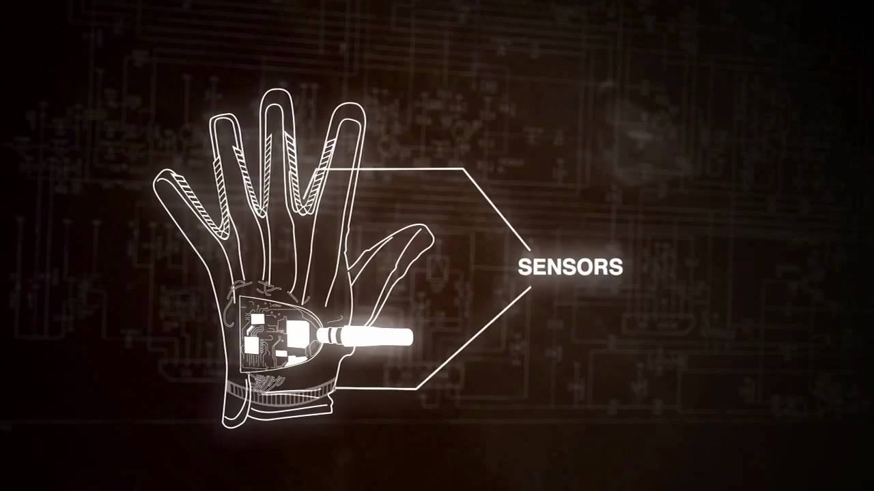
Project General Description
American Sign Language Interpreter
Create a more personal connection between a mute person and a person who lacks sign language knowledge
Translate the American Sign Language hand motions to corresponding English letters vocally

Slide 3
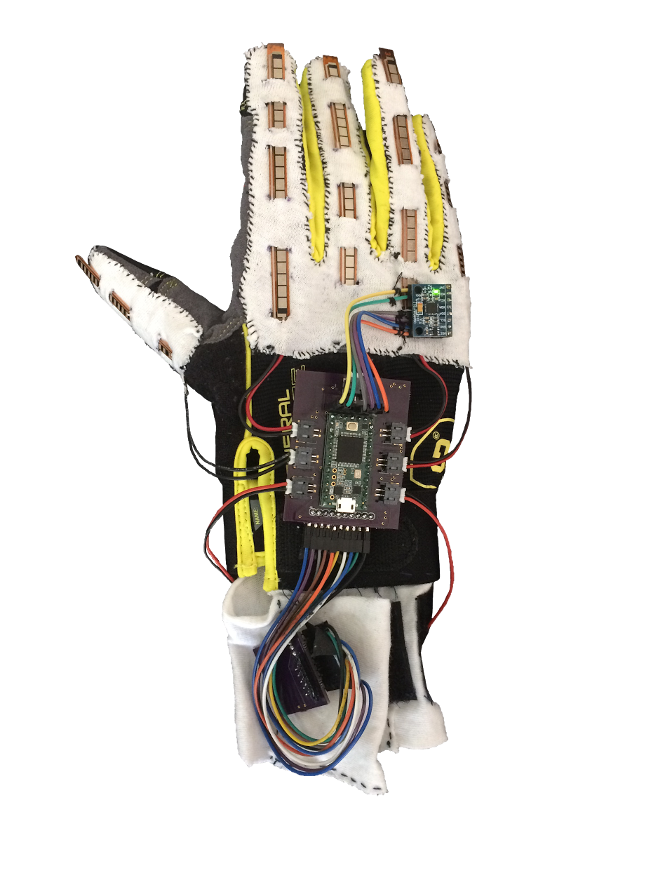
Final Specifications/Requirements
Two Components: Glove and Speaker Module
Battery life of >50 minutes
Detect letters A - Z hand motions
> 90% accuracy
Wireless Communication
Weight: 125g
Cost less than $200 to produce

Slide 4
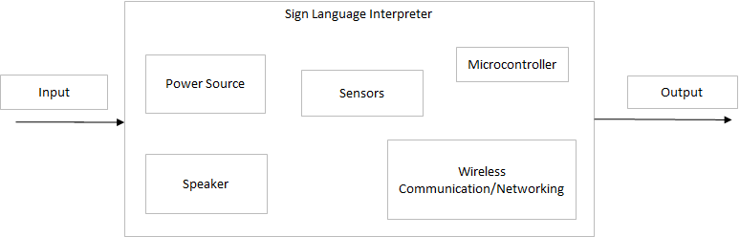
Top-Level Design

Slide 5
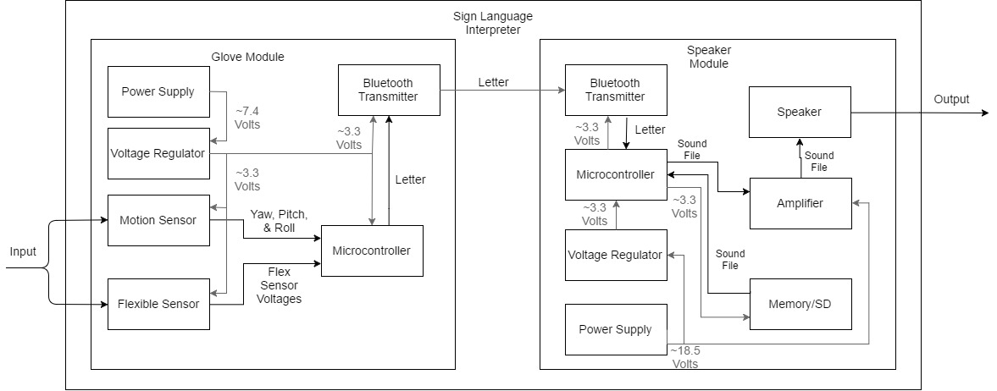
Bottom Level Design

Slide 6
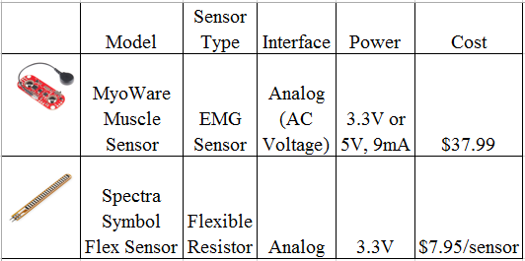
Finger Position Sensors

Slide 7
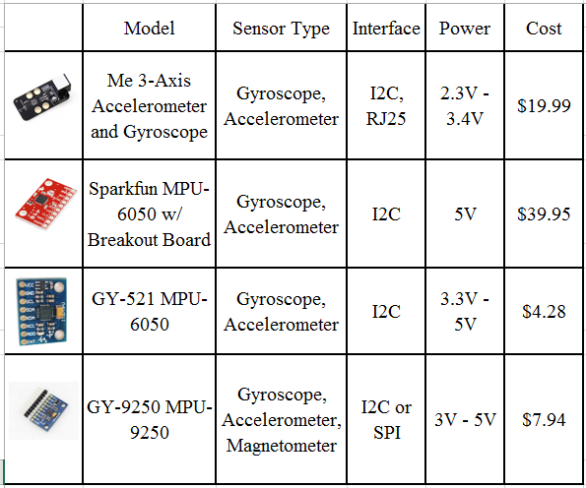
Hand Motion Sensors

Slide 8
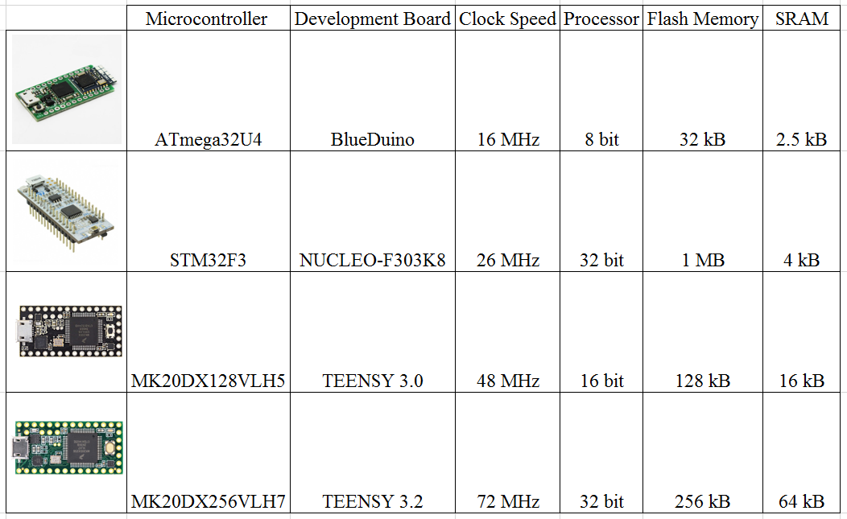
Microcontrollers
Notes:
Realized that using the ATmega32U4 would not be sufficient for running all of the needed processes.
It did have all of the connections however too weak…
Mainly signal processing efficiency… (long ints are usually 32 bits long)
Needed more processing power to run multiple processes at once.
Nucleo board is not compatible with the chosen bluetooth
Price of the two TEENsy boards not very different and the teensy 3.2 has signficantly more processing power and memory.

Slide 9
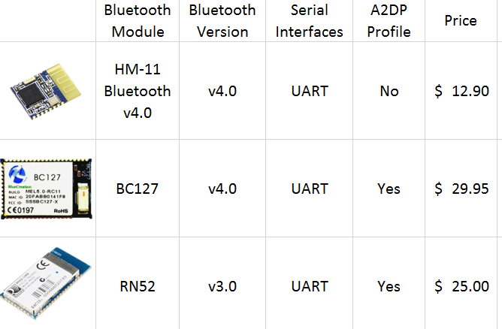
Bluetooth

Slide 10
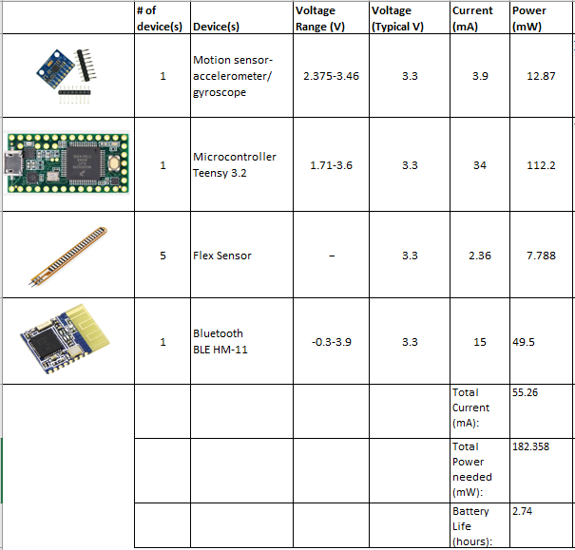
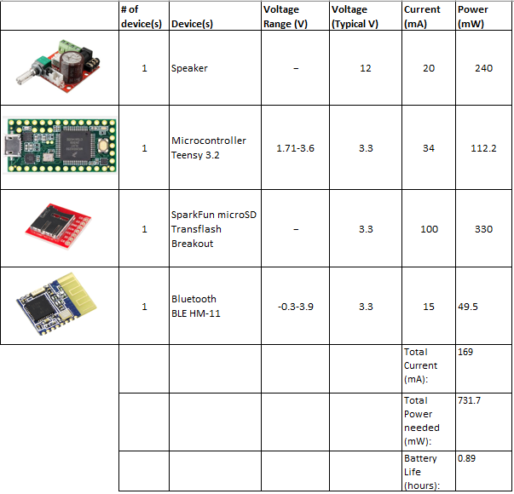
Power Budget
Glove Module
Speaker Module

Slide 11
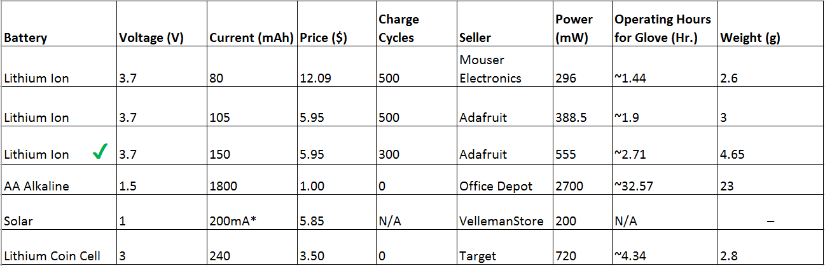
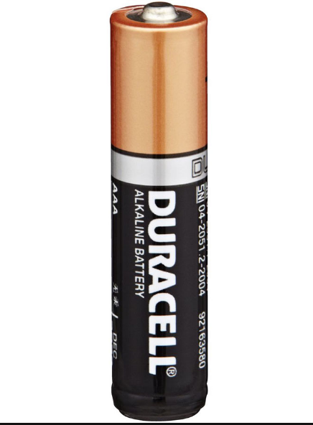
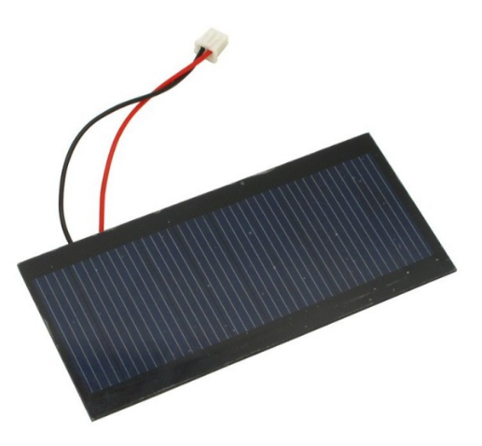
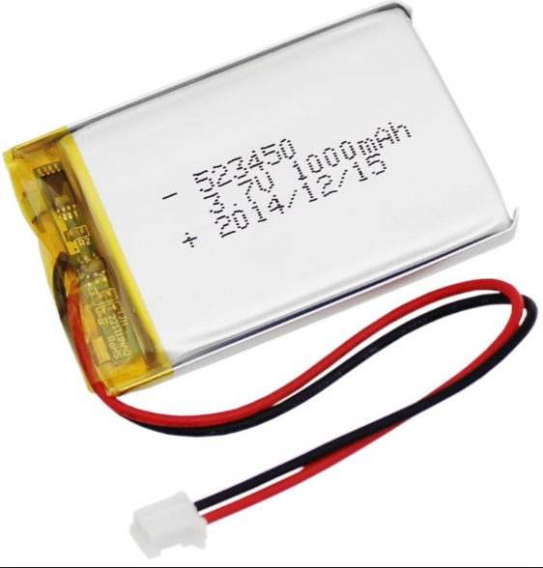
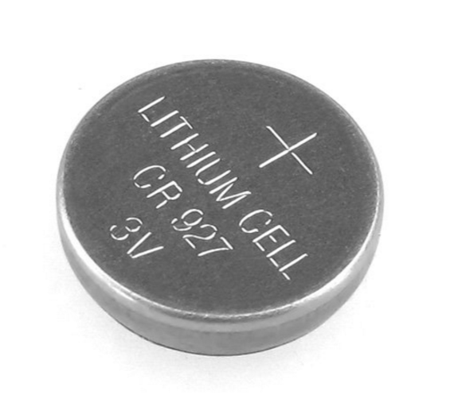
Power Source

Slide 12
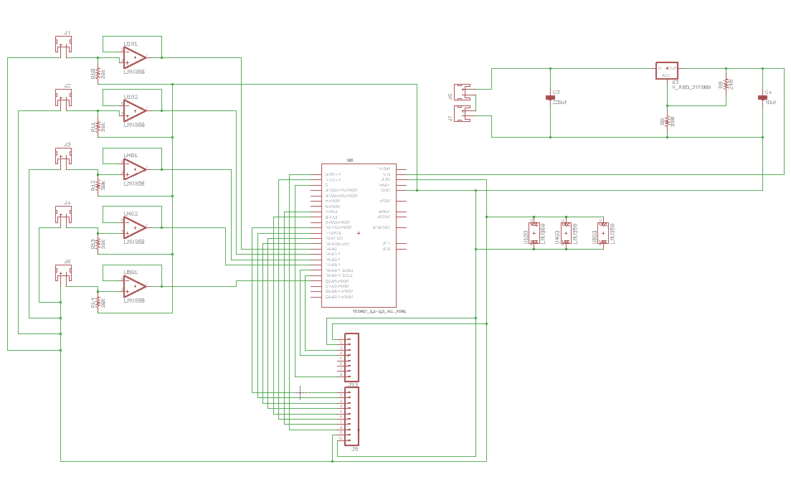
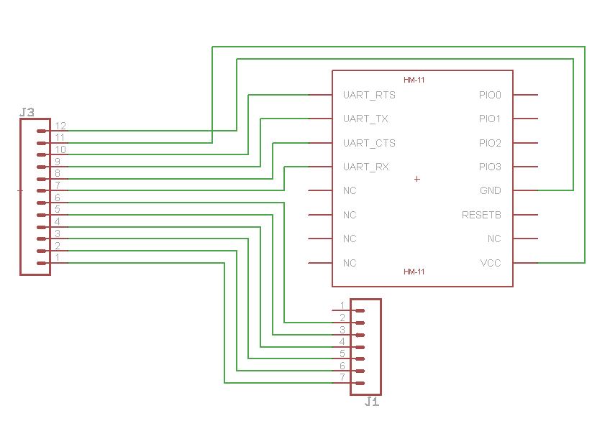
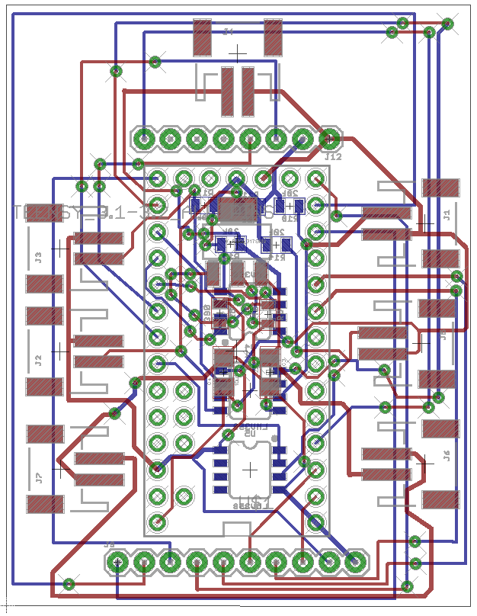
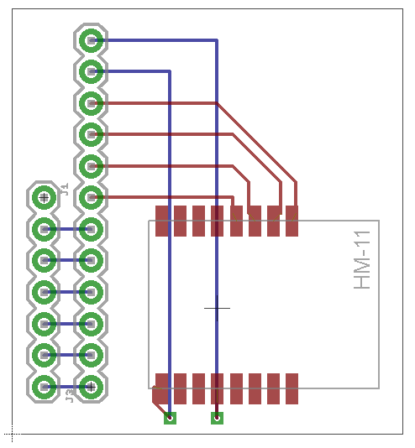
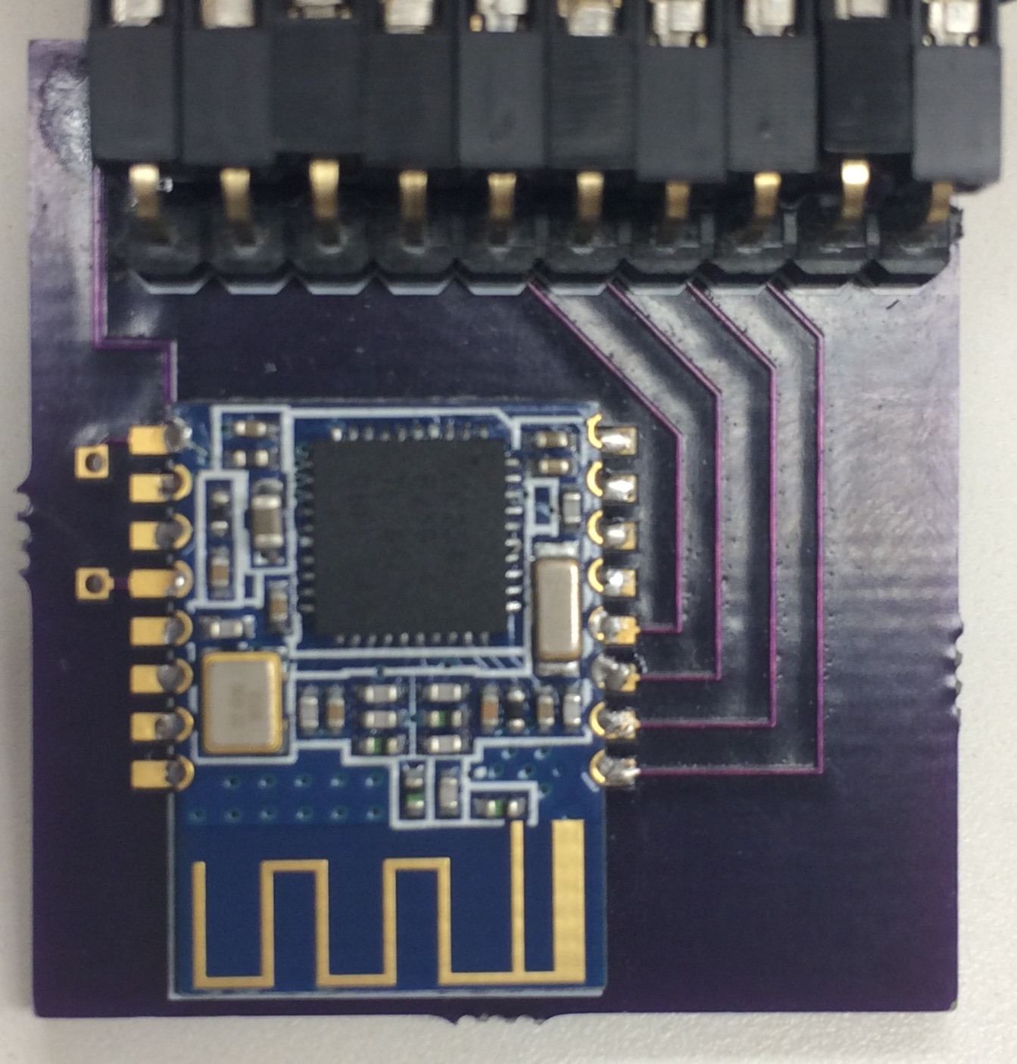
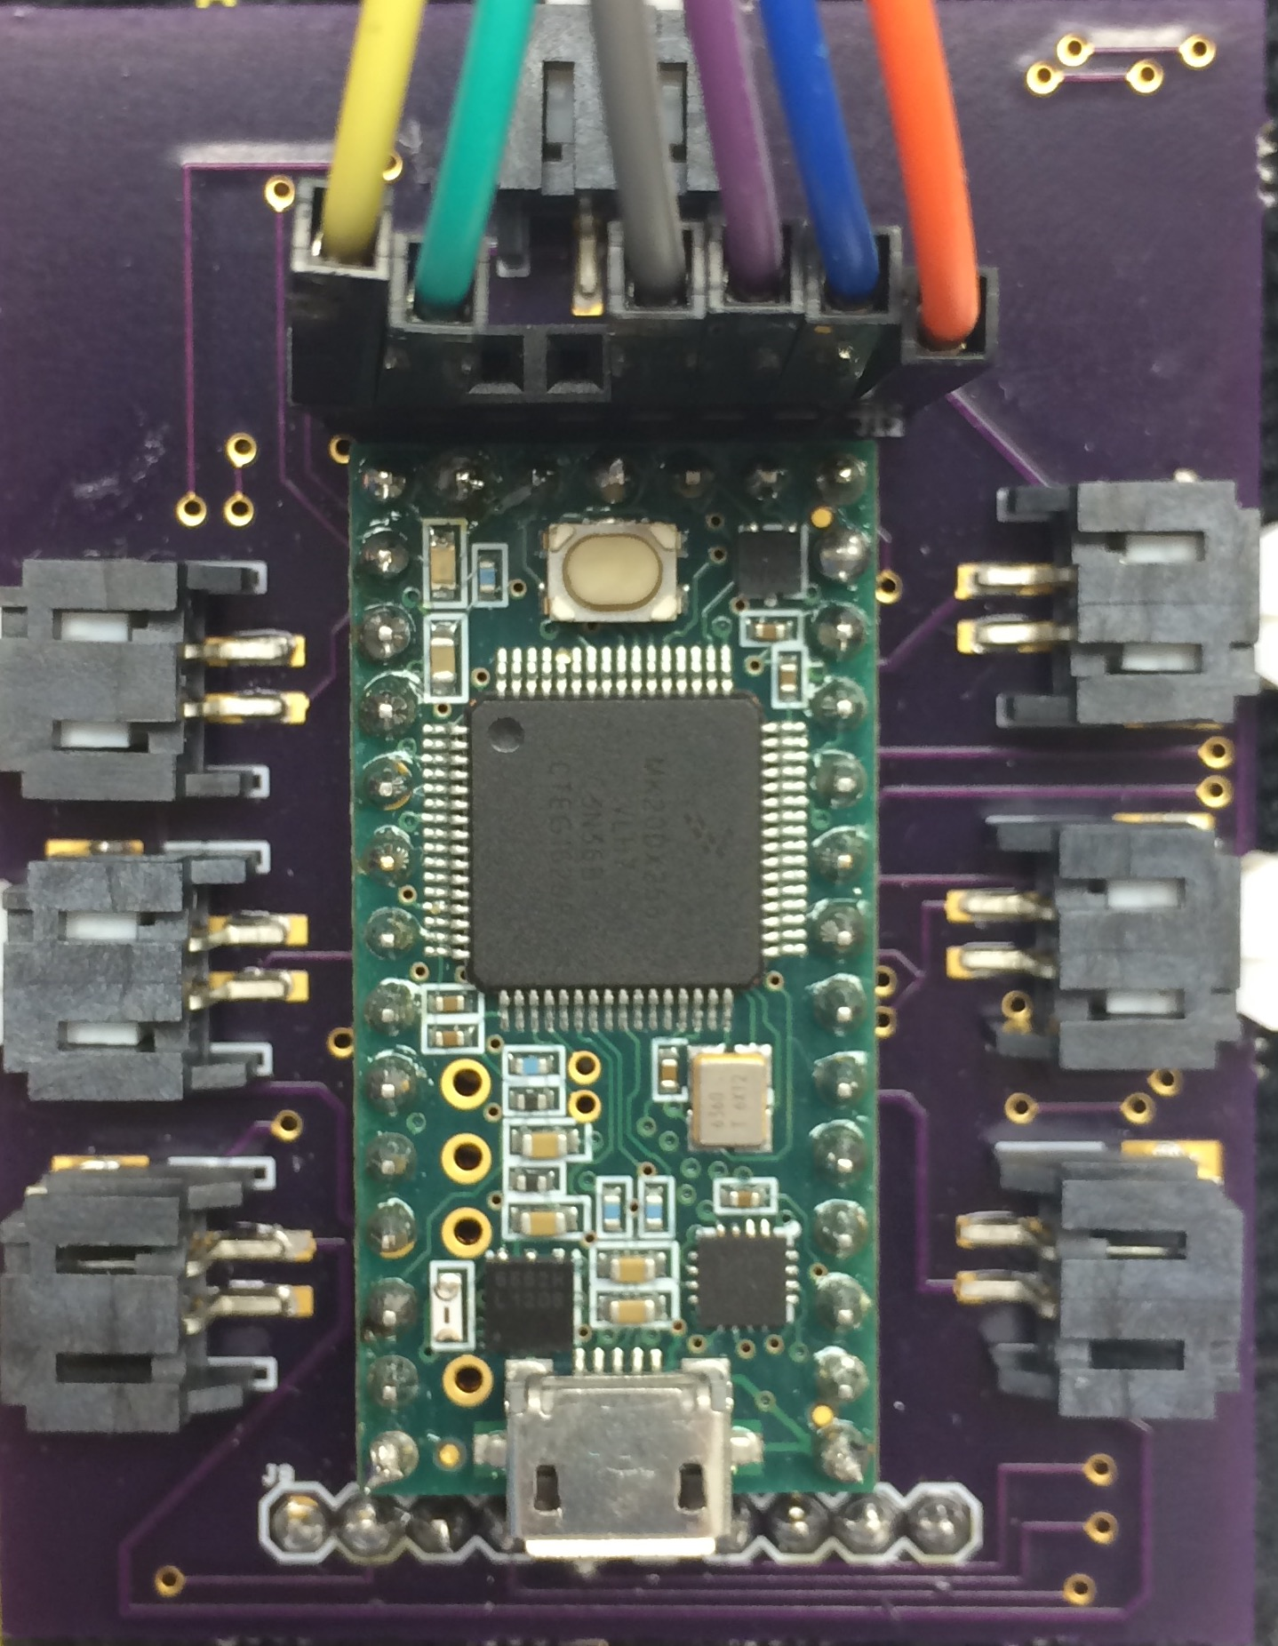
PCB Design
Sensor Shield
Bluetooth Shield

Slide 13
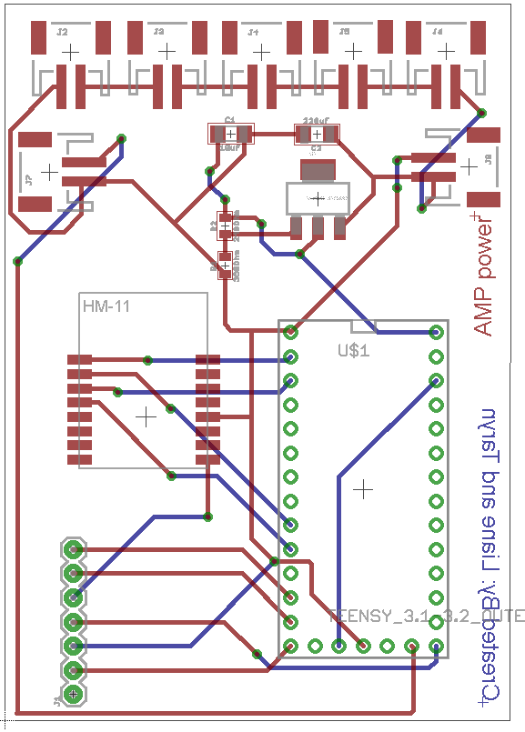
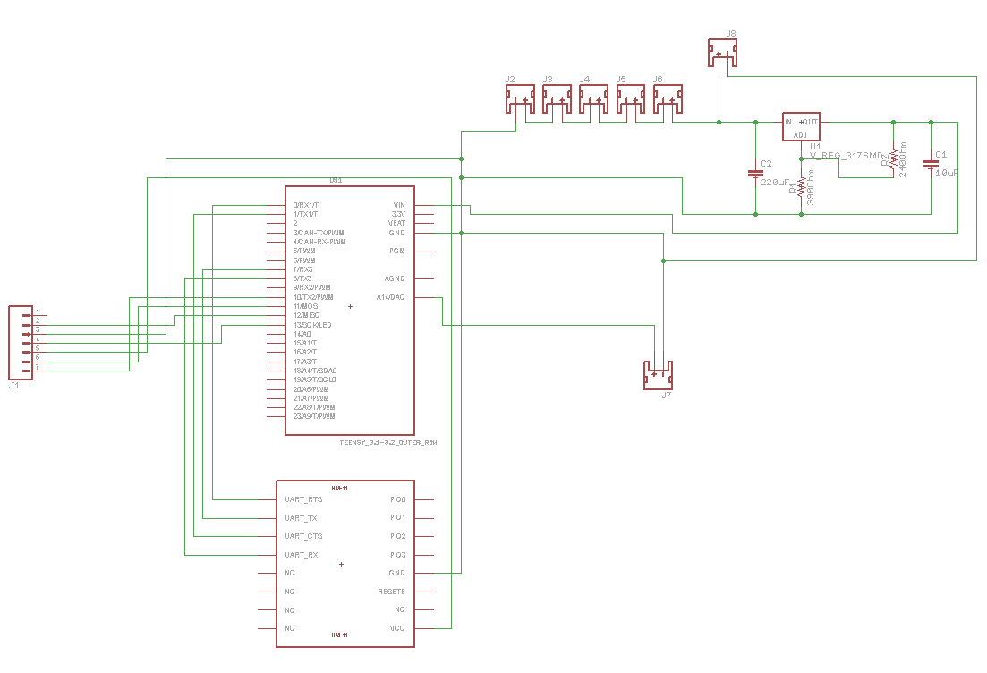
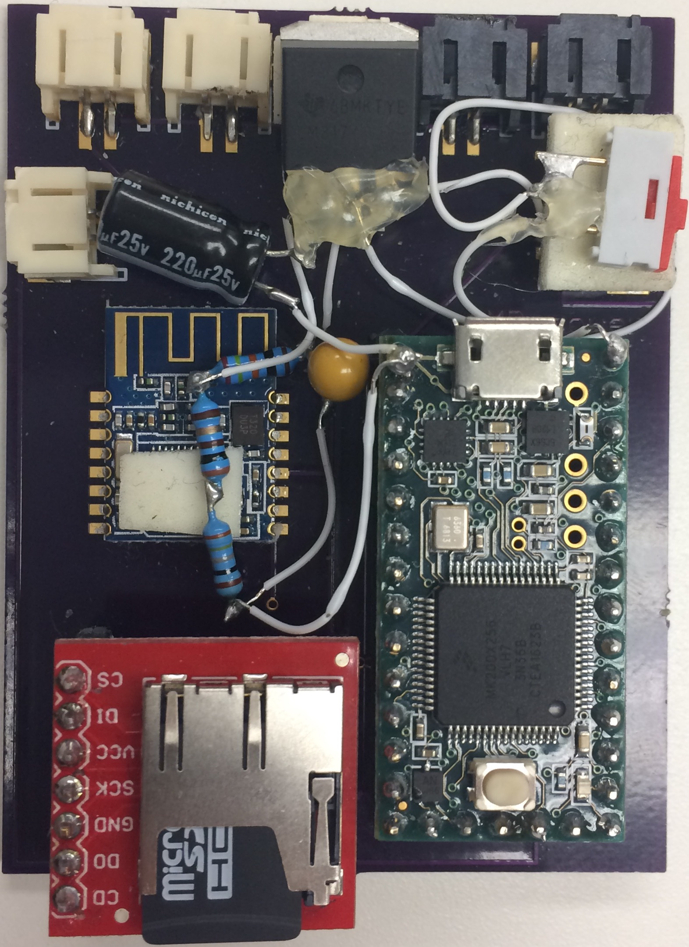
PCB Design
Speaker & SD Shield

Slide 14
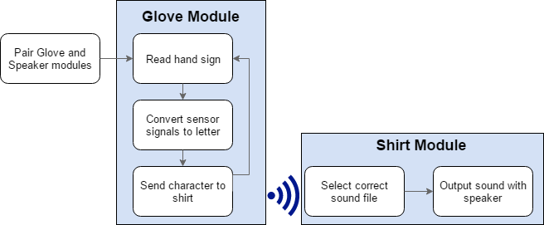
Software Components

Slide 15



Software Used
Notes:
C to initially develop the letter characterization algorithm

Slide 16
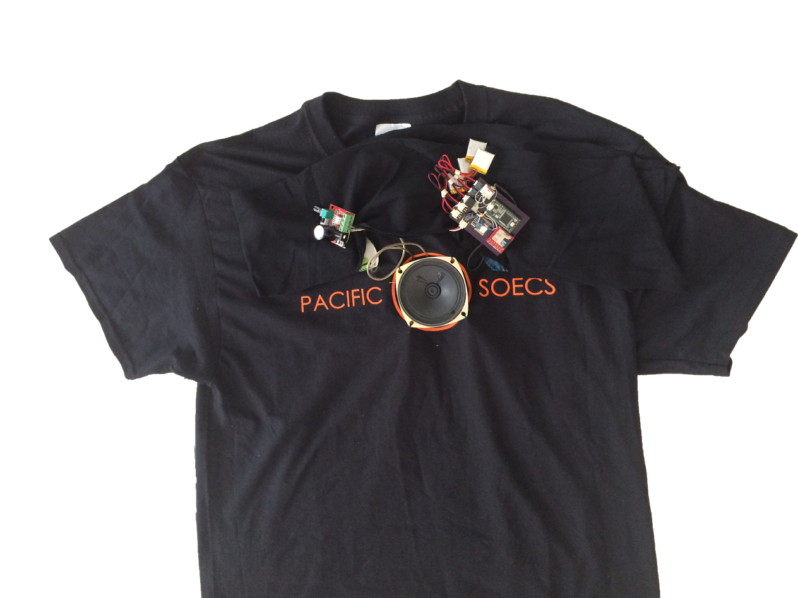
Fully Assembled Fully Interfaced System

Slide 17
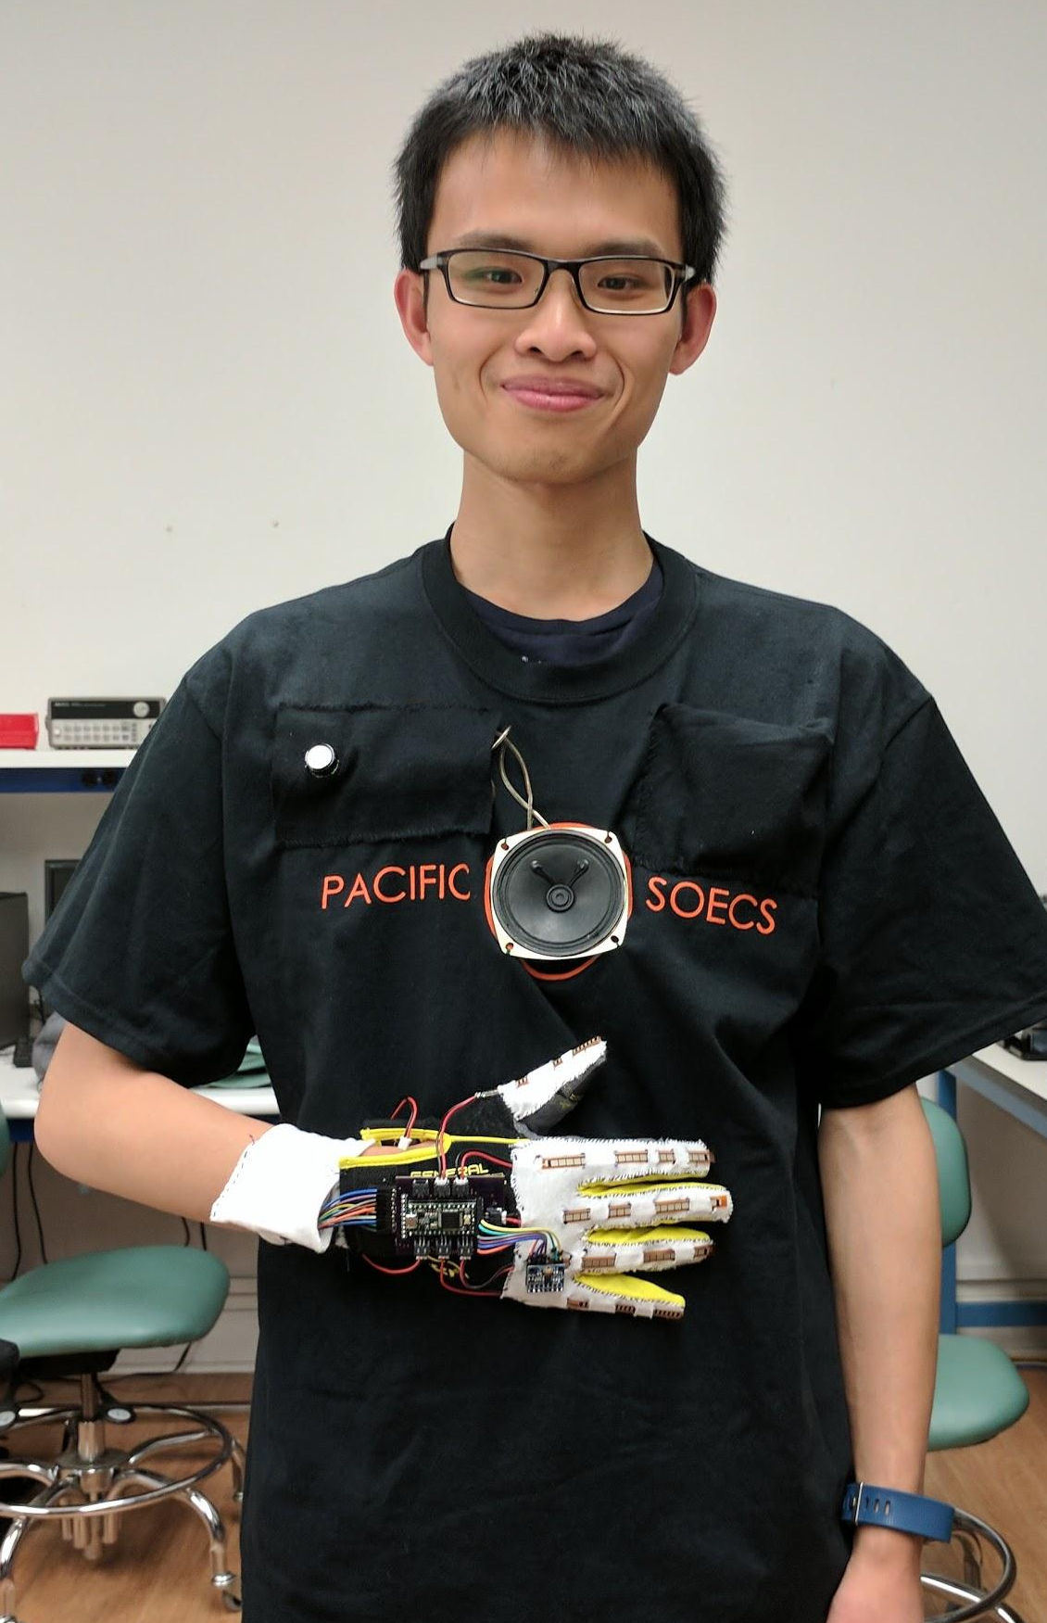
Final Deliverables

Slide 18
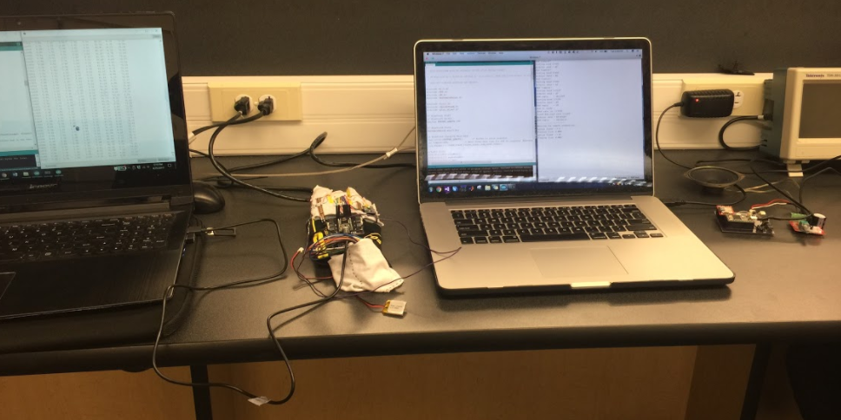
Bluetooth Testing

Slide 19
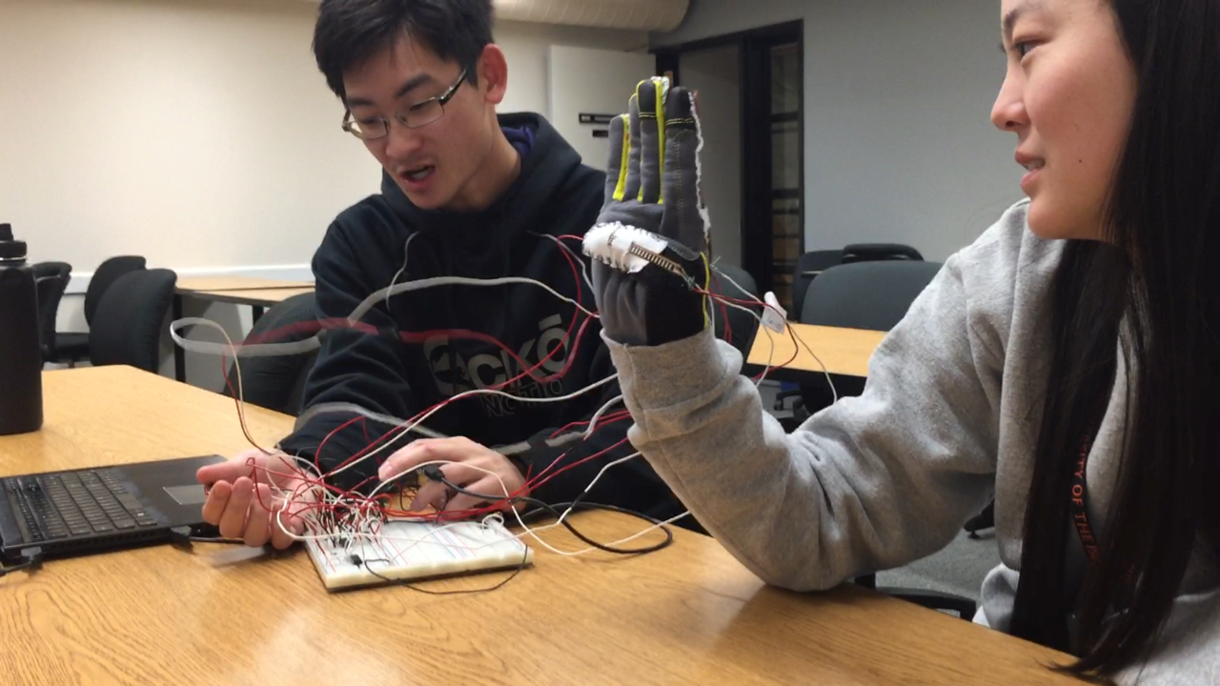
Data Collection

Slide 20
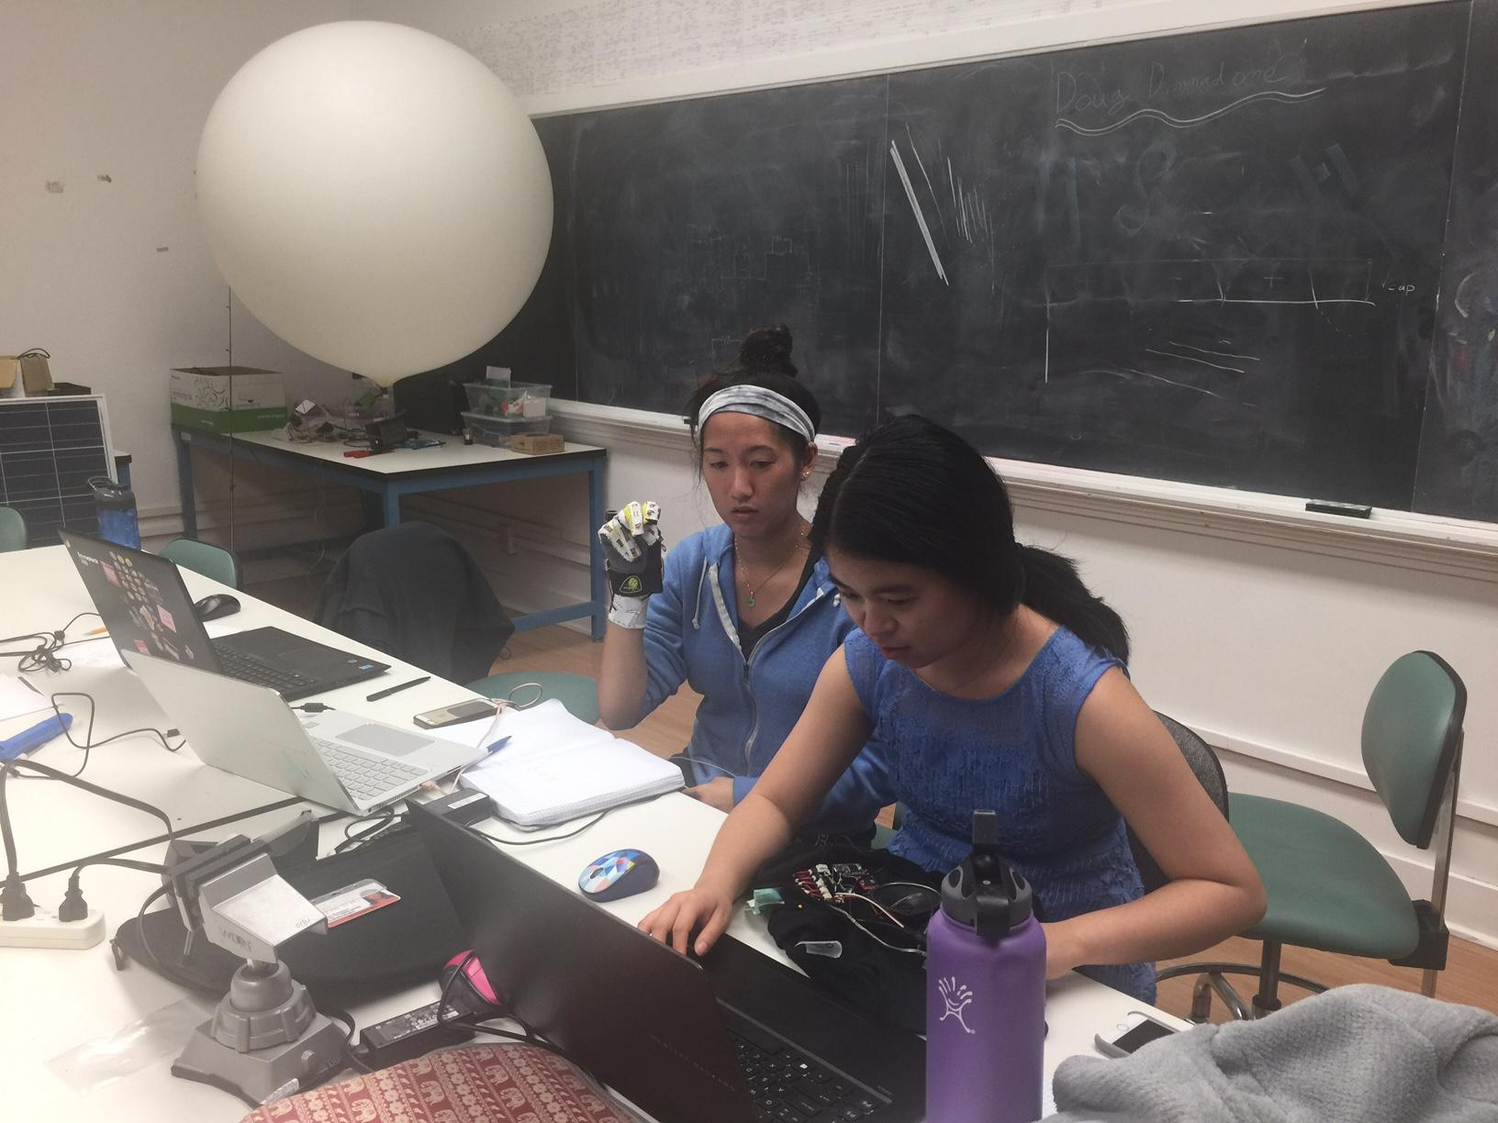
Letter Characterization Testing

Slide 21
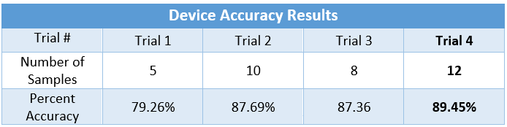
Results of Fully Interfaced System

Slide 22
Results of Fully Interfaced System

Slide 23
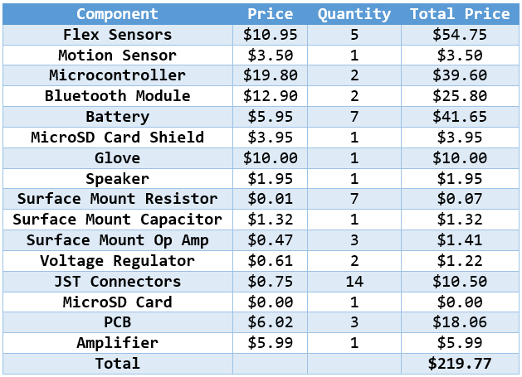
Dollar Budget

Slide 24
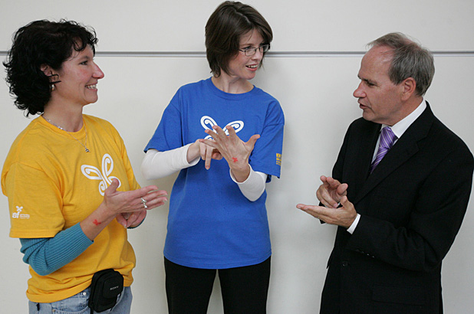
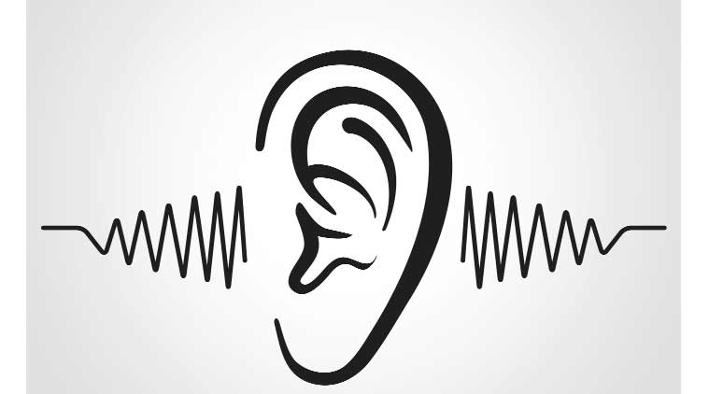
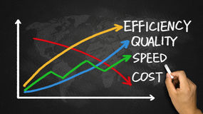

Real World Applications
Bridges communication gap
Uses sound functionalities
Offers portability, accuracy,
and cost-effectiveness
Incorporates longevity and reusability

Slide 25
References
https://github.com/PaulStoffregen/Audio/blob/master/examples/WavFilePlayer/WavFilePlayer.ino
https://cdn-shop.adafruit.com/product-files/1317/C1515_-_Li-Polymer_402025_150mAh_3.7V_with_PCM.pdf
https://github.com/Electroholics/CodeREPO/blob/master/MPU_6050.ino
https://engineering.stackexchange.com/questions/3348/calculating-pitch-yaw-and-roll-from-mag-acc-and-gyro-data
https://github.com/jpliew/BLEShieldSketch/blob/master/HM_10_Test.ino
https://cdn.sparkfun.com/datasheets/Sensors/ForceFlex/FLEXSENSORREVA1.pdf
https://cdn.sparkfun.com/datasheets/Sensors/ForceFlex/FLEX%20SENSOR%20DATA%20SHEET%202014.pdf
http://www.ti.com/lit/ds/symlink/lm317.pdf

Slide 26
Acknowledgements
Dr. Vivek Pallipuram for his support as our project sponsor and for answering questions regarding project specifications and references
Dr. Rahim Khoie for guiding us through the design viability of our project
Dr. Elizabeth Basha for answering questions regarding sensors, PCBs, microcontrollers, and testing methods
Dr. Cherian Mathews for answering questions on Signal Processing
Mark Foreman for ordering and providing parts, assisting with the bluetooth modules and fixing PCBs
Iain Murphy for help on speaker module
Jonathan Moreno for an emergency microcontroller
Jackie Koyama, Kourtnie Sicam, Lauren Anderson, & Brianna Moorehead for being a test subject

